Slide 1
Case Presentation:M. Denver
DRSS Memorial Hospital
Keaton Bonds & Ean Milligan
Dayton Regional STEM School

Slide 2
History and Physical
What is the problem?

Slide 3
Patient ID and Chief Complaint
Name: Madeline Denver
Age: 2 years
Gender: Female
Chief Complaint: Difficulty Walking
Parents have noticed unusual walking, crawling, and speech development. Patient has never been able to walk.
Calves appear to be unusually large and firm.

Slide 4
Past Medical History
Patient has no history of any recorded medical conditions
Not currently on any medications
Notes:
Presenting Your Patient
A Guide for Medical Students Rotating in the Emergency Department
Modified from original document for the SAEM Undergraduate Education Committee
By Tamara Howard, MD and Kerry B. Broderick, MD

Slide 5
Social History
Madeline Denver has
Normal diet
Little exercise, as she struggles to move
Madeline Denver lives
In a rural two story farm house
With Parents and younger brother
Notes:
Presenting Your Patient
A Guide for Medical Students Rotating in the Emergency Department
Modified from original document for the SAEM Undergraduate Education Committee
By Tamara Howard, MD and Kerry B. Broderick, MD

Slide 6
Physical Findings
Vitals
Temperature, Pulse, and Blood Pressure are normal for age
Weight and Height are in the 50th percentile
Overall Appearance
Well appearing, Alert, Oriented (for her age)
Neck and Back
Neck supple, No enlarged lymph nodes, Full range of Motion, No tenderness
Cardiovascular
Heart has regular rate and rhythm, peripheral and central, pulses strong and equal bilaterally
Skin
Warm, Dry, No rashes or lesions
Musculoskeletal
Calf enlargement, diminished lower extremity strength, no tenderness
Neurological
Cranial nerves intact, Low strength; Normal sensation, reflexes equal bilaterally, and gait; No signs of cerebellar dysfunction; alert and oriented
Notes:
Presenting Your Patient
A Guide for Medical Students Rotating in the Emergency Department
Modified from original document for the SAEM Undergraduate Education Committee
By Tamara Howard, MD and Kerry B. Broderick, MD

Slide 7
Problem List
Problems
1. Unusual walking, crawling, and speech development
2. Low Muscle Strength
3. Calf Enlargement
Cells affected appear to be muscle cells
Differential Diagnosis
1. Muscular Dystrophy
Patient shows weak muscles and unusually large and firm calves and also has trouble walking/crawling
2. Down Syndrome
Patient shows decreased muscle tone
3. Tay-Sachs Disease
Patient shows decreased muscle tone
Notes:
Presenting Your Patient
A Guide for Medical Students Rotating in the Emergency Department
Modified from original document for the SAEM Undergraduate Education Committee
By Tamara Howard, MD and Kerry B. Broderick, MD

Slide 8
Diagnosis
What is causing the problem?

Slide 9
Diagnosis
Muscular Dystrophy
Matching Symptoms:
Diminished lower extremity strength
Difficulty beginning to walk
Calf enlargement
To confirm this, we suggest one or more of the following
CPR Testing: Finding excess CPR from broken muscle cells
DNA Testing: Determine if an axon is missing.
Muscle Biopsy: Examine muscle structure for excess fat and connective tissue.

Slide 10
Causes
Muscular Dystrophy is caused by the removal of an exon on the DMD gene on Chromosome X. This can either cause Duchenne or Becker Muscular Dystrophy.
Duchenne
75% of Muscular Dystrophy
Gene suffers a frameshift mutation
Protein immediately destroyed by cell
Becker
Gene suffers a missense mutation
Protein works partially, effects are slowed
Both cases, the protein cannot hold some proteins to the cell membrane in muscle cells, making it more prone to rupture and die
The cells that die are replaced usually by satellite cells
When satellite cells can’t keep up, muscle cells are replaced with conductive tissue and fat

Slide 11
Inheritance
Where did the problem come from?

Slide 12
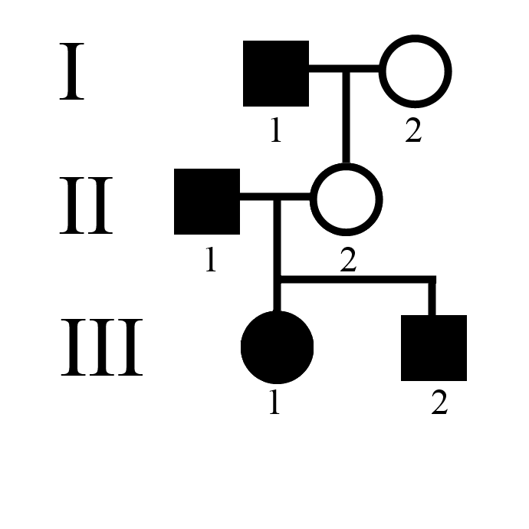
Pedigree and Punnett Square
 |  | Mother’s Alleles
 |  | X^{H} | X^{h}
Father’s Alleles | X^{H} | X^{H}X^{h} | X^{H}X^{H}
 | Y | X^{H}Y | X^{h}Y

Slide 13
Current Treatments
MD treatments typically include
Physical therapy
Prednisone
Used early on or during increases in symptoms
Many side effects
Mood changes
Weight gain
Sleep disturbance

Slide 14
Questions?
Thank you for your time.???????????????????????????????

